Slide 1
CSOPESY Week 4
Creating Customized CLI Layouts
Enzo Arkin Panugayan

Slide 2
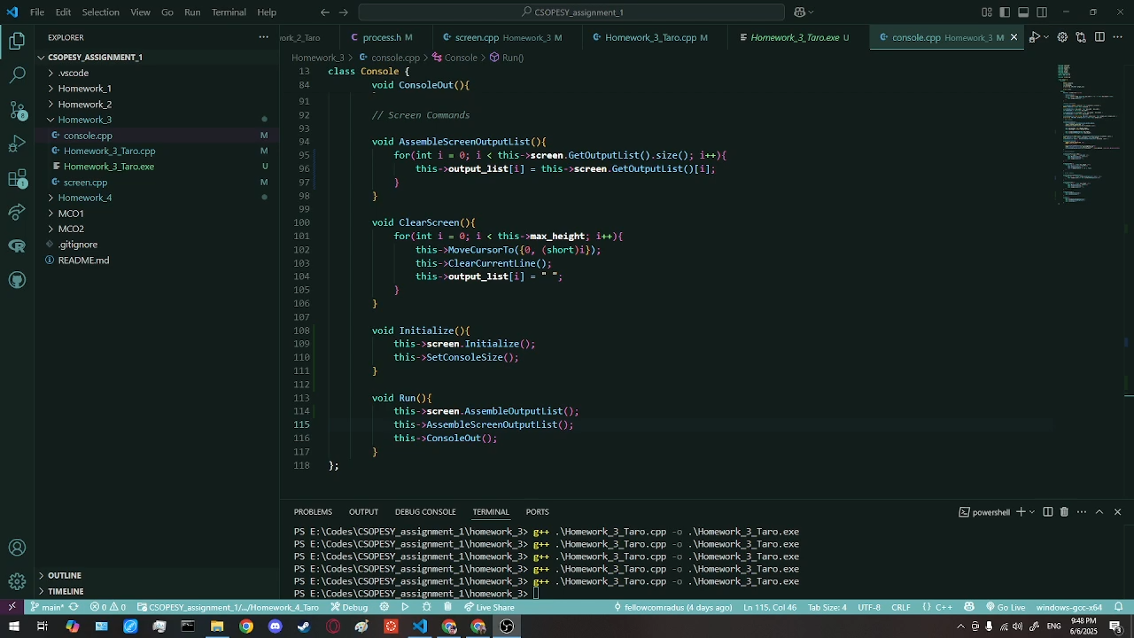

Slide 3
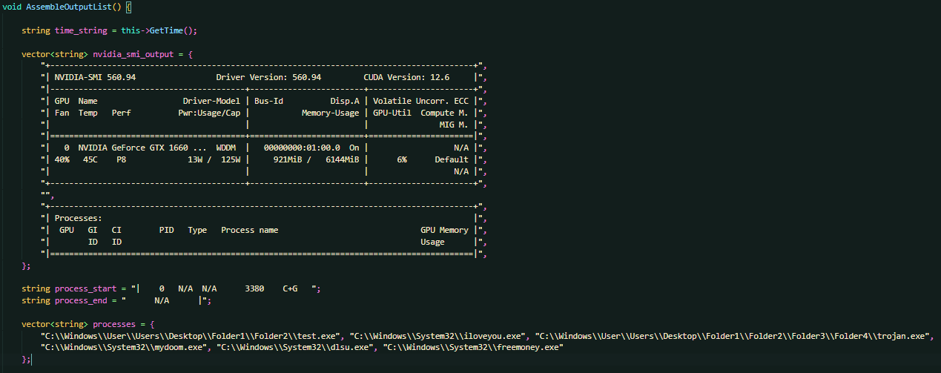
Initialization
Since the main focus was the processes portion, I just did out on the other data
The processes are listed below which some of them are long while some are short

Slide 4
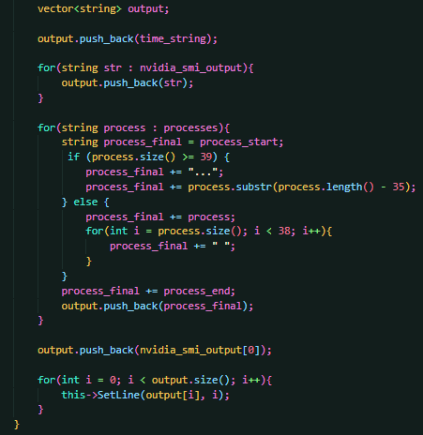
Logic
How the process name was shortened was by taking the length of the process to check if its 39 or more
If its 39 or more, it’s too long so we need to cut it into just 36 characters and add the … at the front
If its less than 39 characters, we just need to keep adding spaces to fill the rest of the missing space

Slide 5
End of slides

